Slide 1
Ensemble Learning

Slide 2
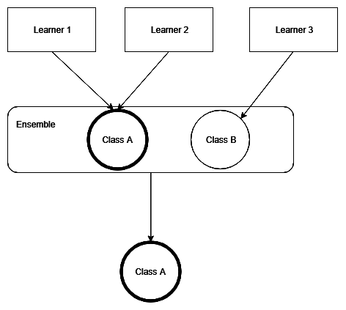
Voting
majority voting
Hard voting
投票最多的就是獲勝者
 | Class A | Class B | Class C
Learner 1 | 0.5 | 0.3 | 0.2
Learner 2 | 0 | 0.48 | 0.52
Learner 3 | 0.4 | 0.3 | 0.3
Soft voting
軟投票考慮了預測類別的概率
 | Class A | Class B | Class C
Learner 1 | 0.5 | 0.3 | 0.2
Learner 2 | 0 | 0.48 | 0.52
Learner 3 | 0.4 | 0.3 | 0.3
Average | 0.3 | 0.36 | 0.34

Slide 3
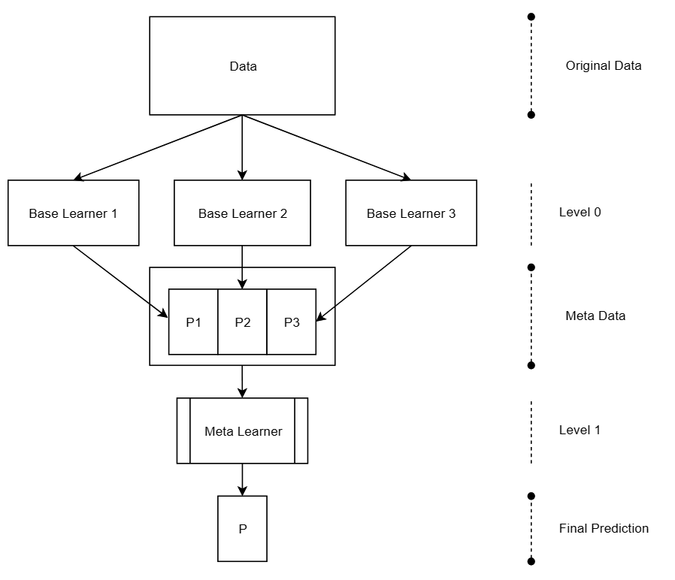
STACKING
Meta-learning
use base learners in order to generate metadata for the problem's dataset and then utilize another learner called a meta-learner, in order to process the metadata.
Base learners are considered to be level 0 learners, while the meta learner is considered a level 1 learner.
In other words, the meta learner is stacked on top of the base learners, hence the name stacking.
用基礎學習器來為問題的數據集生成元數據，
然後使用另一個稱為元學習器的學習器來處理元數據。
基礎學習者被認為是 0 級學習者，
元學習者被認為是 1 級學習者。
換句話說，元學習器堆疊在基礎學習器之上，因此得名堆疊。

